Slide 1
Memfull: Your Ultimate Travel Companion
Welcome to Memfull, the revolutionary travel platform that transforms your exploration experience. Discover personalized recommendations, detailed insights, and must-visit locations near you. Say goodbye to travel planning headaches and hello to seamless adventures!

Slide 2

Revolutionizing Travel Planning
1
Recommendations
2
Detailed Insights
Access comprehensive information about destinations. Make informed decisions quickly and easily.
Receive tailored suggestions based on community pulse and location. Discover hidden gems effortlessly.
3
Simplified Planning
Streamline your travel preparation process. Save time and reduce stress with our intuitive platform.

Slide 3
Addressing Travel Challenges
Before Memfull
With Memfull
Endless searching through YouTube videos and websites. Hours spent gathering basic information. Overwhelming and time-consuming planning process.
Centralized platform for all travel information. Personalized recommendations at your fingertips. Efficient and enjoyable trip planning experience.

Slide 4

The Memfull
1
User-Generated Content
Travelers contribute detailed information and routes to our database. Real experiences shared by real people so, 100% trust
2
No More Scrolling
The Explorer will have the data at their finger tips so, no more searching the internet
3
Efficient Planning
Budget your adventures accurately. Ensure well-planned and enjoyable travel experiences for everyone.

Slide 5
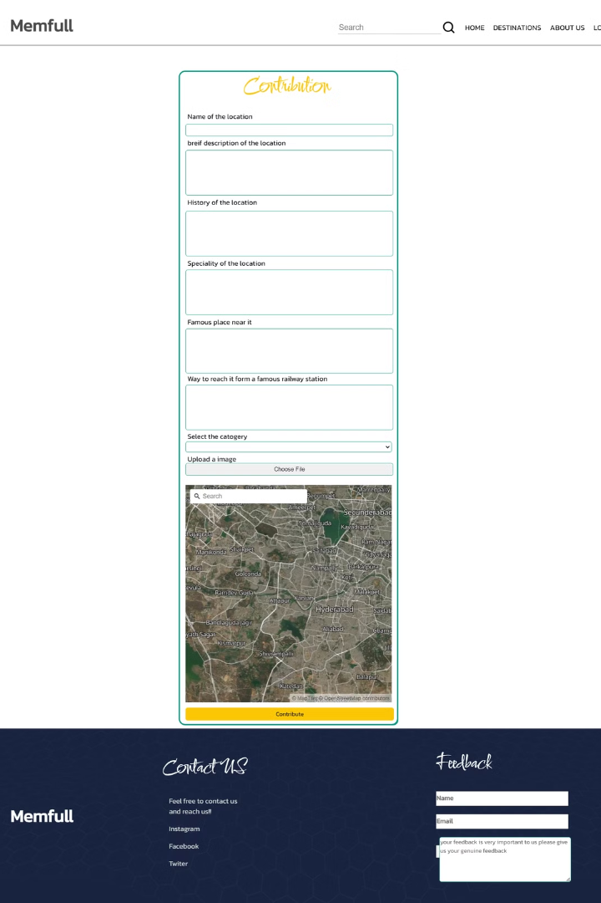
Key Features
Contribution
Here we provide facility to the explorers to contribute their knowledge to the our databases
The database is used by the other explorers to plan their tours

Slide 6
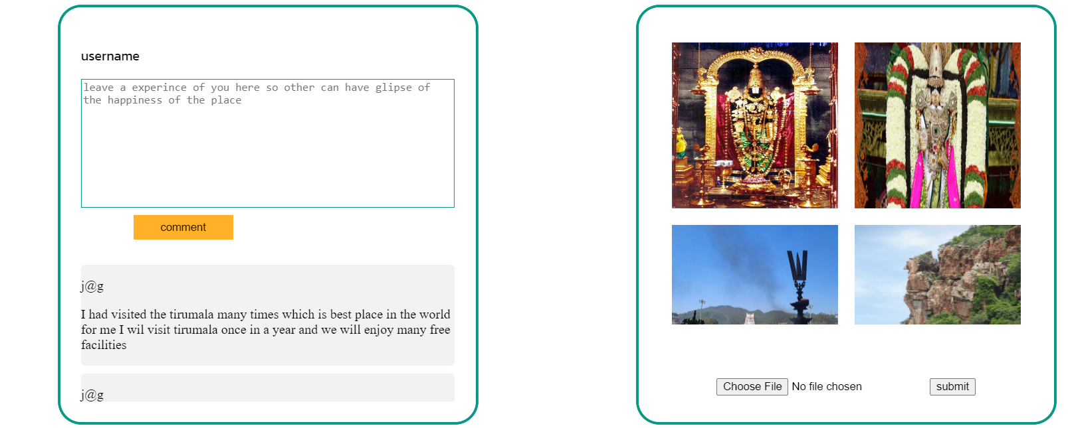


Share Your Experiences
Comment Box
Photo Upload
Share your thoughts and tips with other travelers. Help them experience the joy of exploration.
Show off your adventures with stunning visuals. Inspire others with your travel memories.

Slide 7

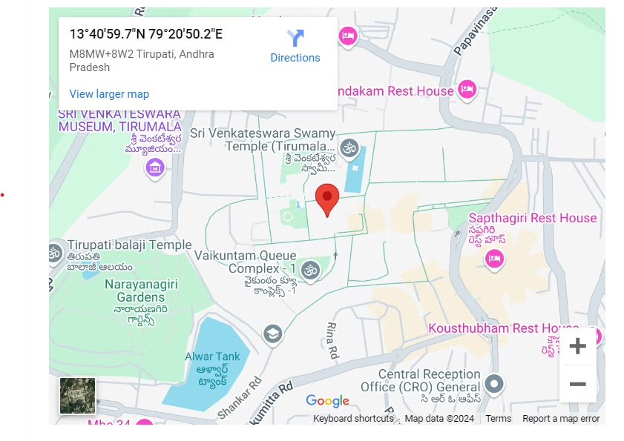
Precision with Geolocation
We provide the geocordinates of the location in the google map so, that it will be easy for the explorer to calculate the distance precise and plan accordingly.

Slide 8
Future Scope
1
Incoperating the Advance technologies
2
Real time wheather updates
3
Collabrating with tour planners
we will incoperate the AI/ML in recommending the destinations according the explorer taste
We will integrate the live wheater updates so, that it will be easy to plan and find best time.
We will collabrate with the local bussinesses to provide discounts for the explorers.
4
Enhance user experince
We will incoporate the other fontend technologies to create a great user experince so, it will be easy to the explorer to interact.

Slide 9
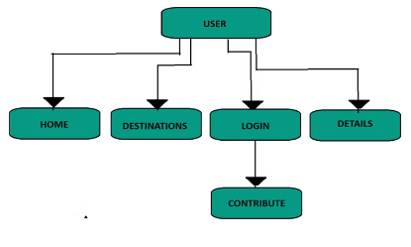
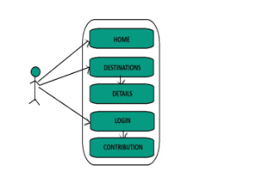
UML Diagrams

Slide 10
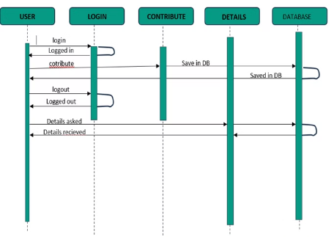

Slide 11
System Layouts

Slide 12
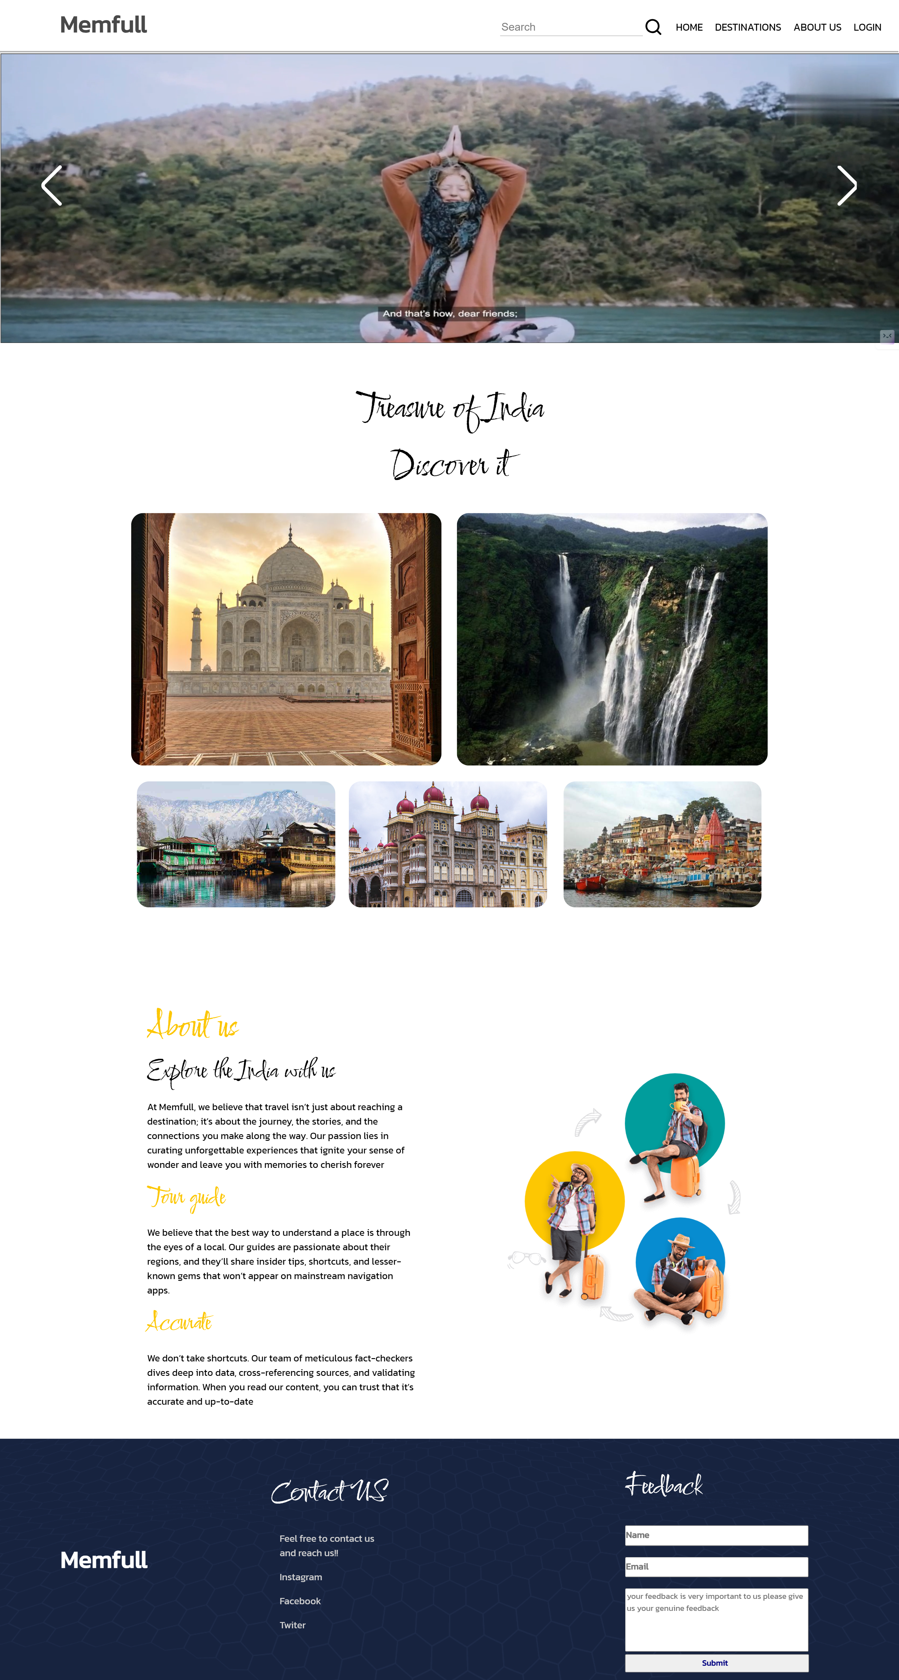

Slide 13
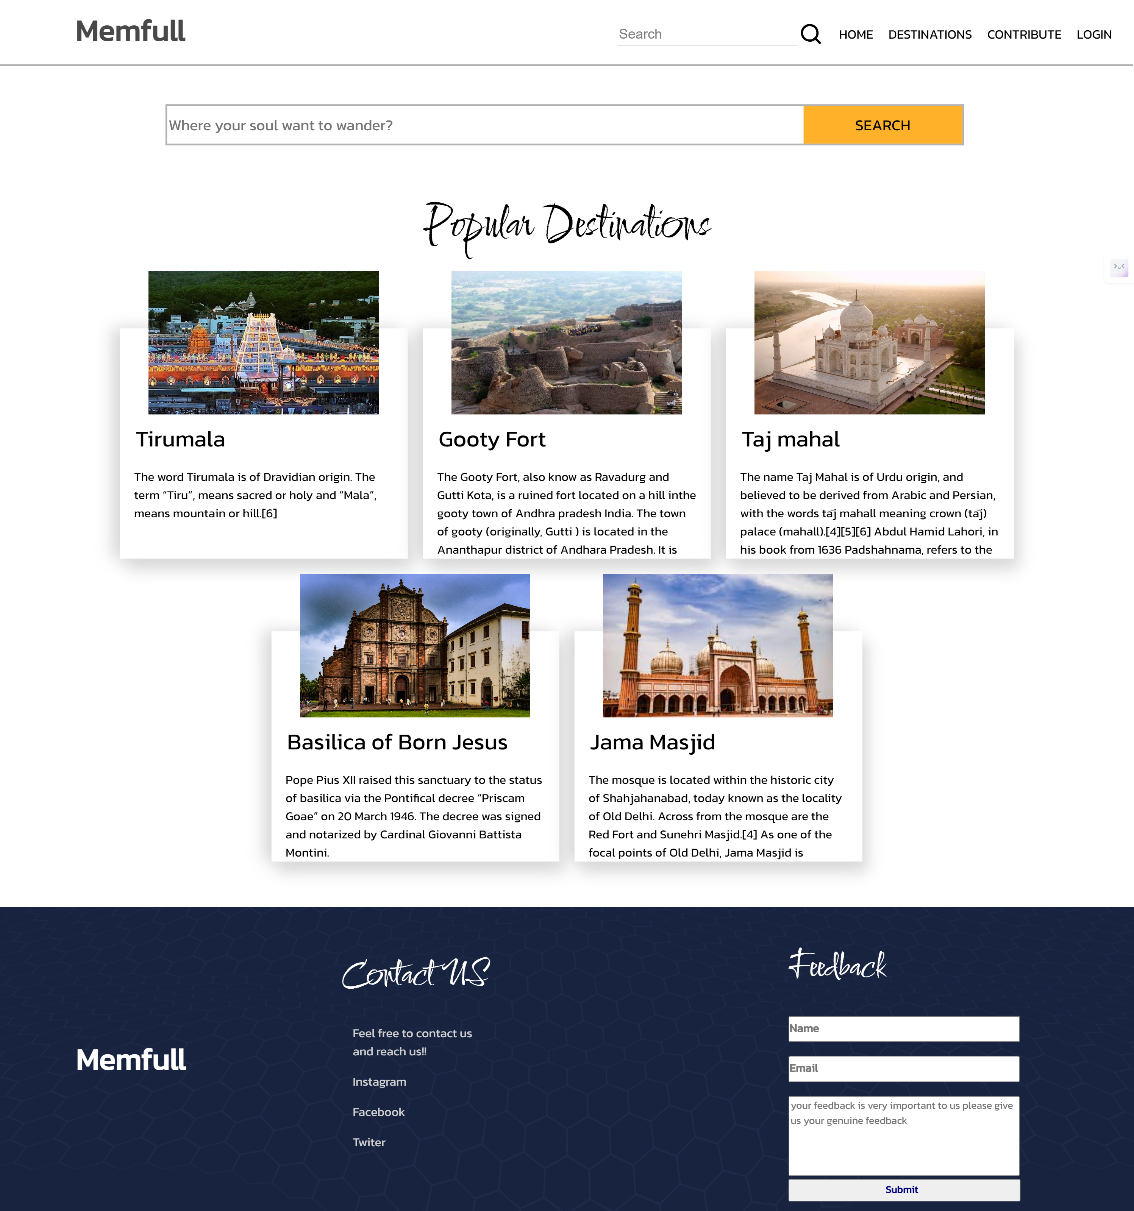

Slide 14
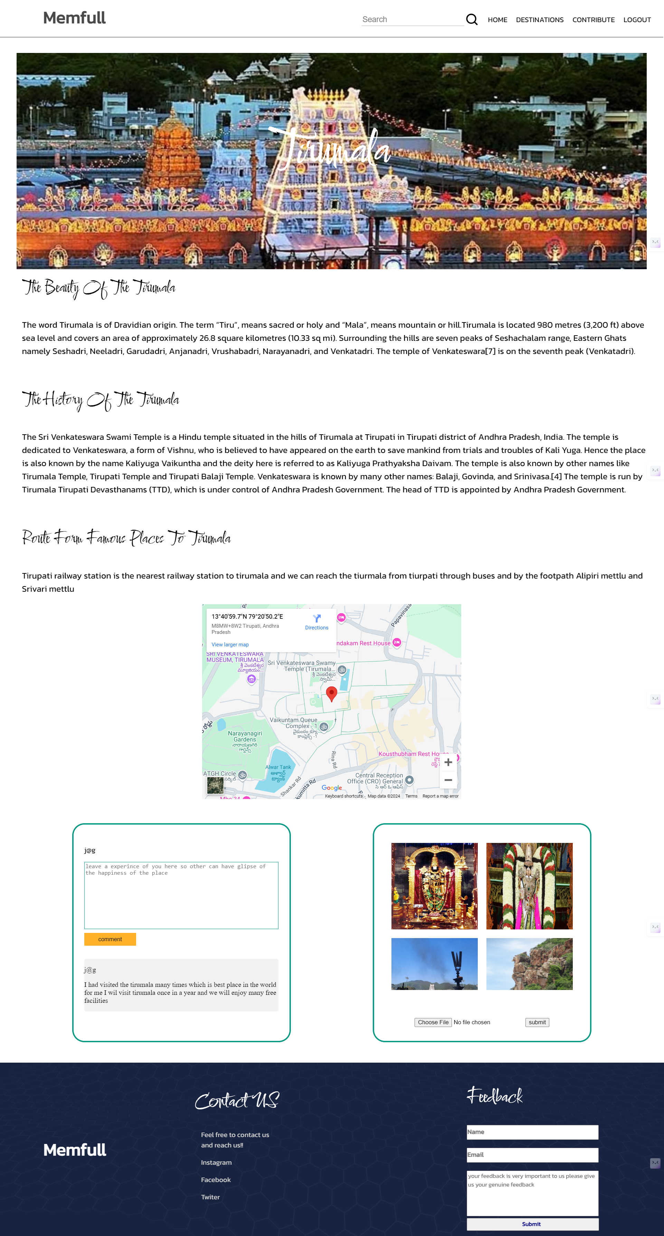

Slide 15
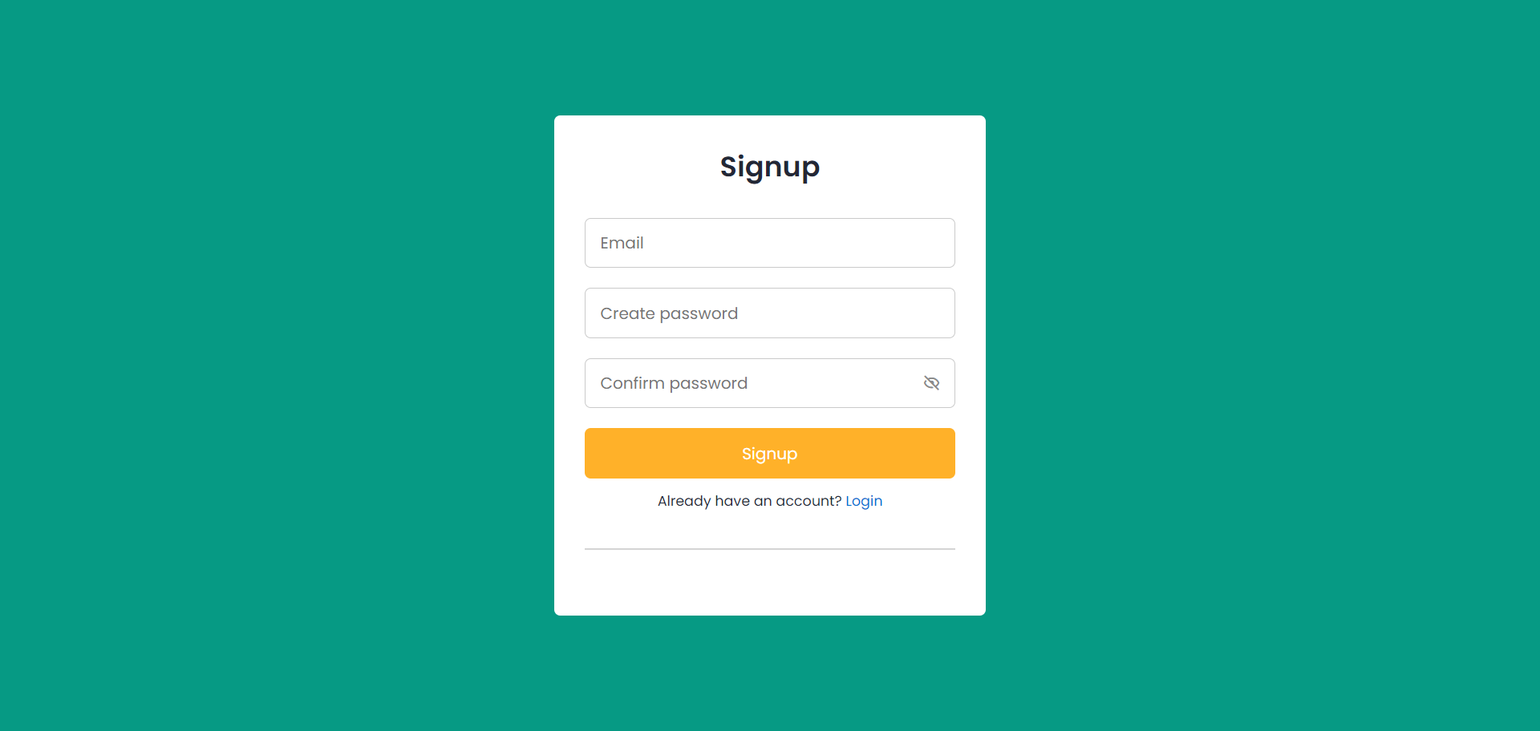

Slide 16
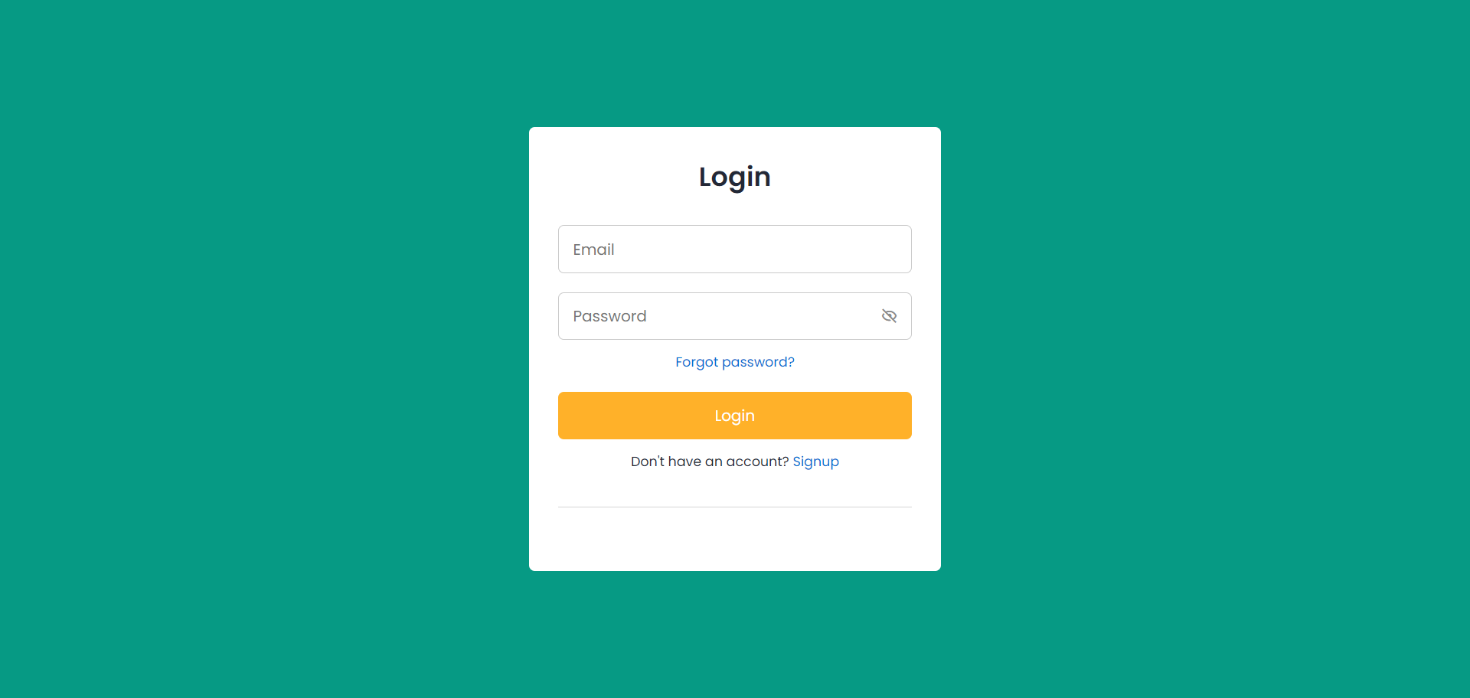

Slide 17
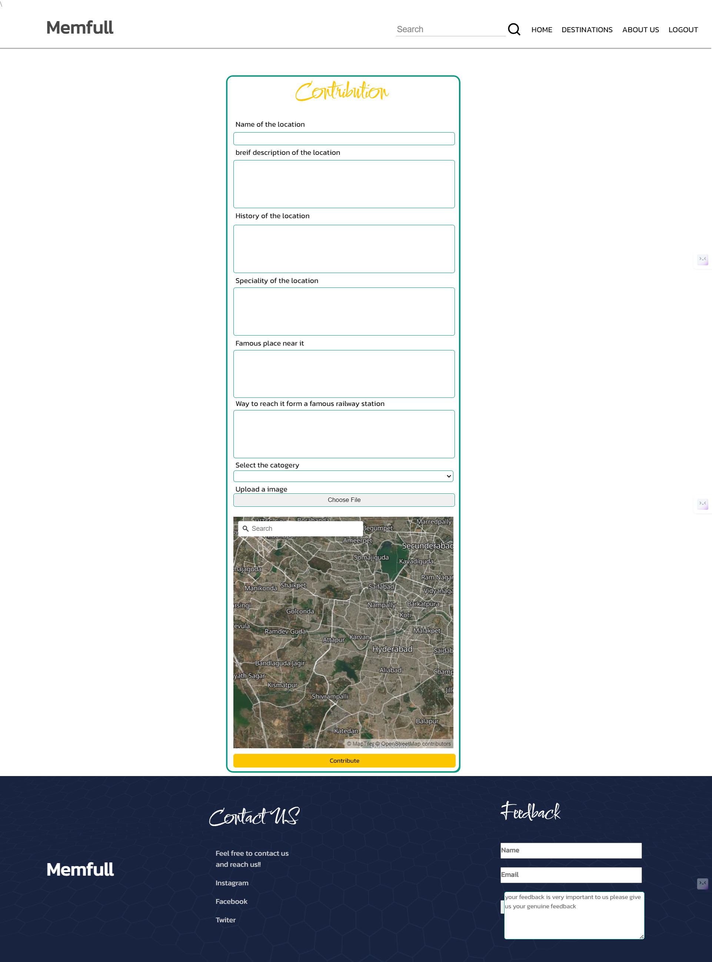

Slide 18
Conclusion
1
In In conclusion, Memfull emerges as a comprehensive platform dedicated to simplifying the travel planning process for explorers and adventurers alike. Our journey begins with the Home Page, providing a seamless entry point to discover a diverse range of must-visit locations. The About Us Page not only elucidates our platform's mission but also highlights our commitment to providing transparent and reliable travel solutions
2
Venturing further, our Destinations Page presents a curated selection of landmarks, natural wonders, and hidden gems, ensuring users can find destinations tailored to their interests and preferences. Meanwhile, our Contact Us Page serves as a direct channel for users to reach out for assistance or inquiries, reaffirming our dedication to customer satisfaction.
3
Looking ahead, Memfull aims to enhance the user experience and engagement through innovative features such as AI/ML integration and real-time weather updates. Additionally, we plan to expand our database to include a wider range of travel experiences, catering to diverse tastes and needs.
4
In summary, Memfull embodies a holistic approach to travel planning, offering a user-friendly platform that prioritizes convenience, transparency, and community engagement. Together, these facets form the essence of Memfull, a trusted companion in the quest for unforgettable adventures

Slide 19
Thank you

